Slide 1
Personal Analytics tools I am using
WorkTime Personal
ManicTime
Visual Time Analyzer
Downloaded from following corresponding links
http://www.worktime.com/personal/
http://www.manictime.com/
http://www.neuber.com/timeanalyzer/index.html

Slide 2
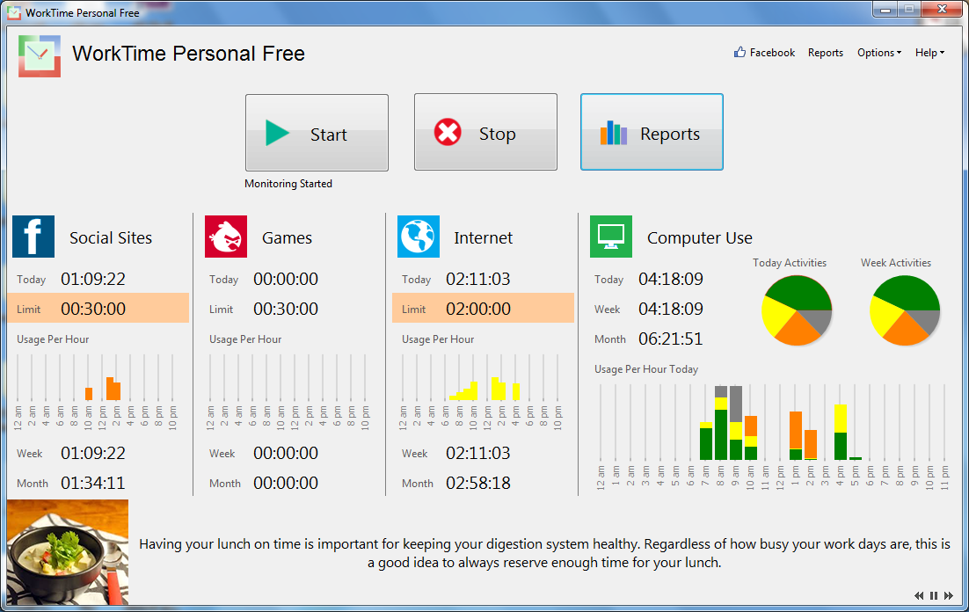
WorkTime Personal

Slide 3
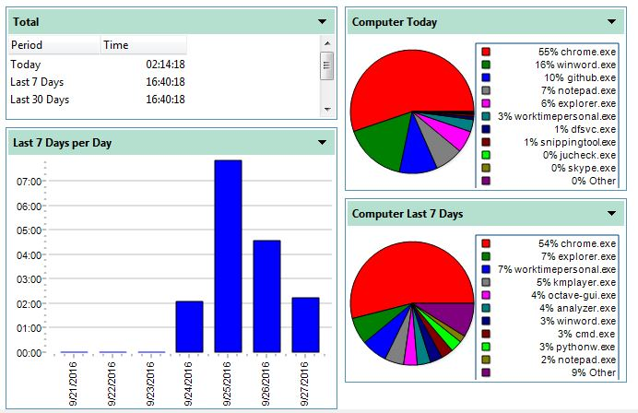
WorkTime Personal – Computer Use

Slide 4
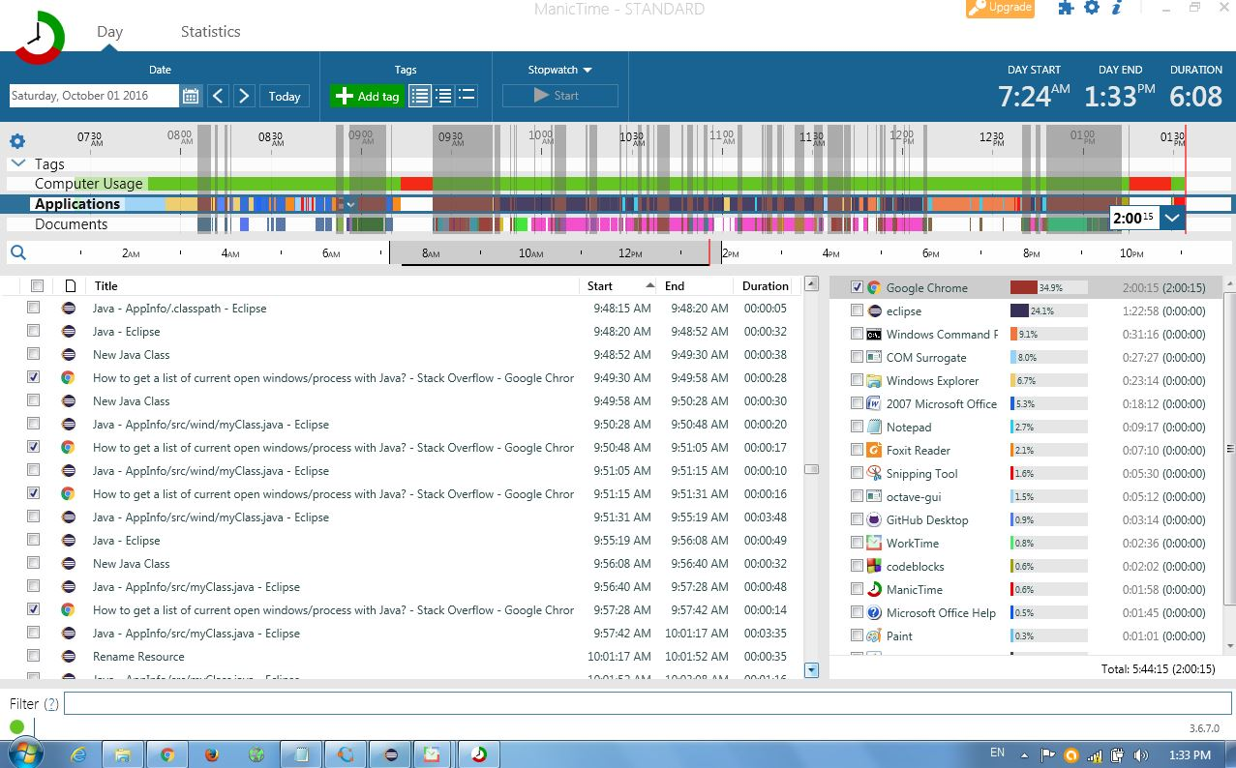
ManicTime

Slide 5
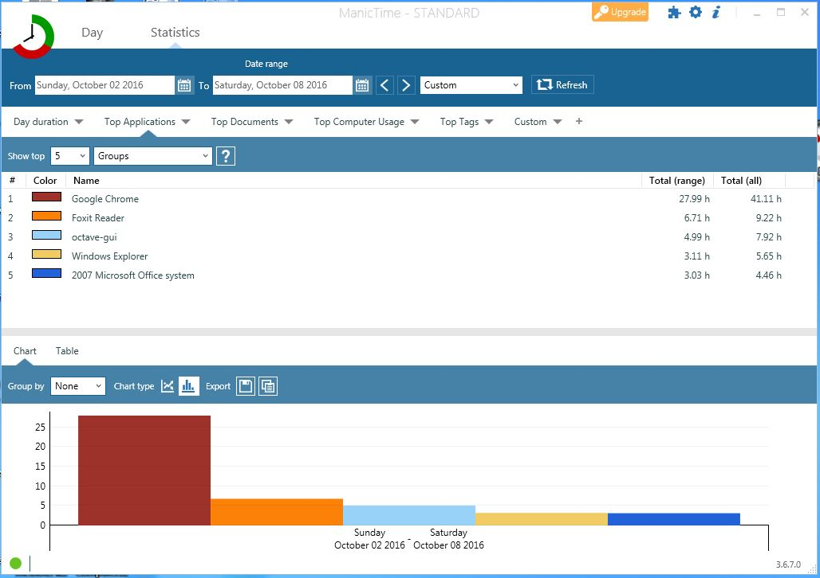
ManicTime – Top Application

Slide 6
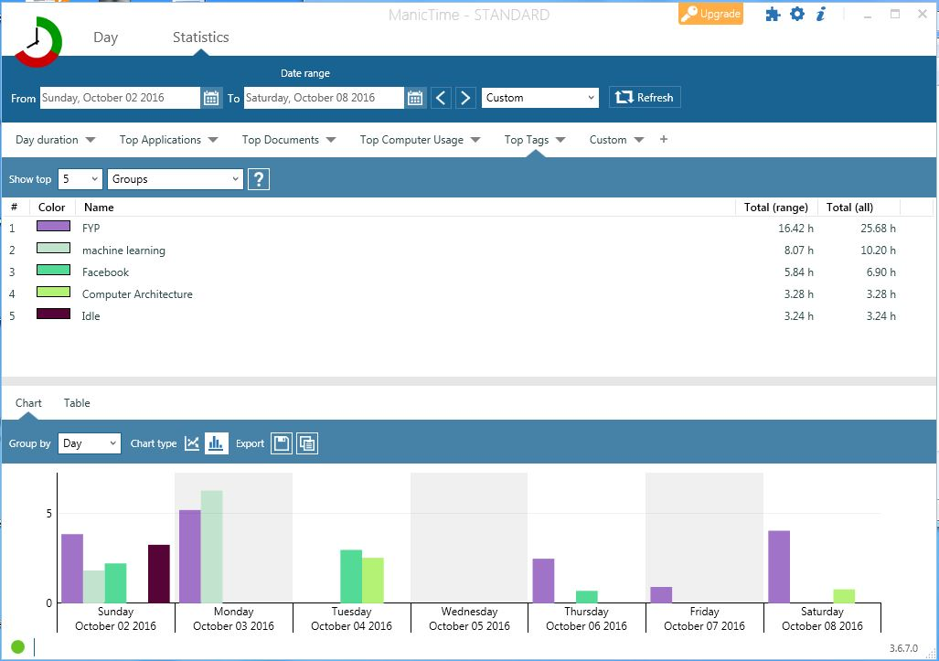
ManicTime – Top Tags

Slide 7
Comparison with our project
Discussed tools
No analysis of data
Only notes Applications and window titles
Our project
Analyze data
Categorize activity nature
“Research” vs “Teaching”

Slide 8
Papers I have read
Personal Visualization for learning
Understanding Quantified-selfers
A stage-based model of personal informatics system

Slide 9
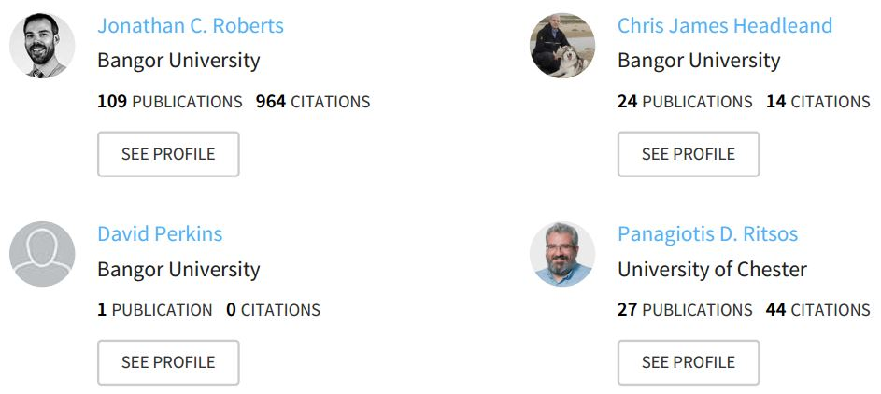
Personal Visualization for Learning
Conference Paper - 2015
4 authors

Slide 10
Personal Visualization for Learning
Research Problem:
Grade, Weightage, Attendance etc
Data on personal learning is lacking
Solution:
Personal Data → Personal Visualization → Personal Learning
Dynamically and regularly update personal data

Slide 11
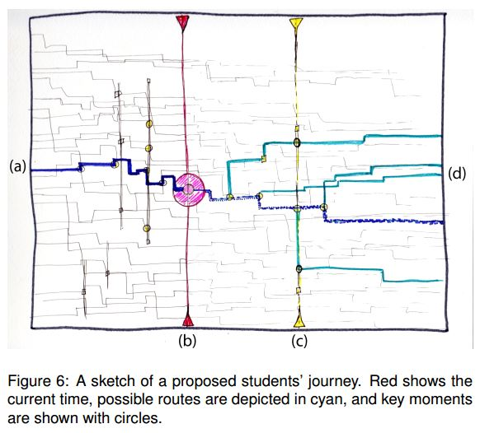
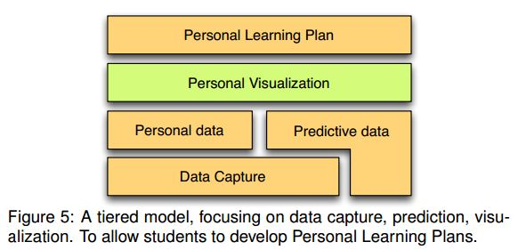
Personal Visualization for Learning
Assumptions:
Proposed tiered approach
Most data captured
Some data predicted

Slide 12
Personal Visualization for Learning
Limitations:
Intrusion into personal life
Security and anonymization priority

